Slide 1
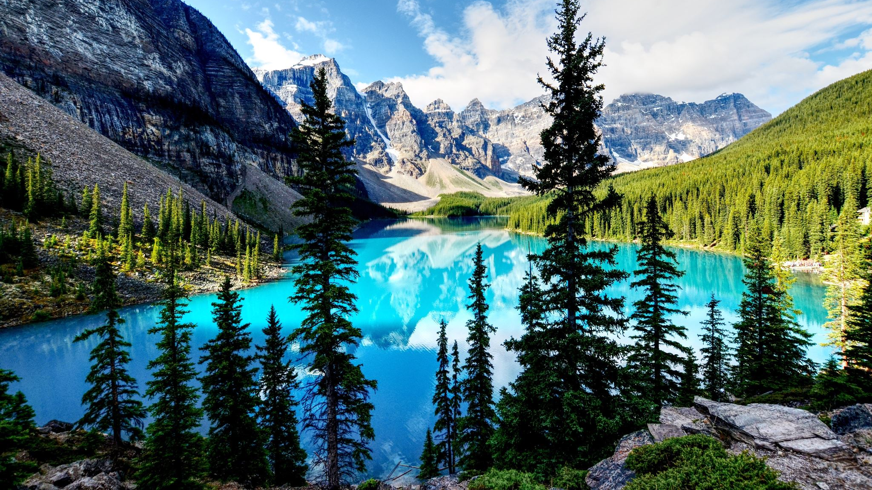
Database ERD System
Presidential election
Group 5 :
Farel
Deni
Petra
Daniel
Wilbert
David

Slide 2
Entities
Party
Voters
Candidate
Election Place
Committee
Security

Slide 3
1NF

Slide 4
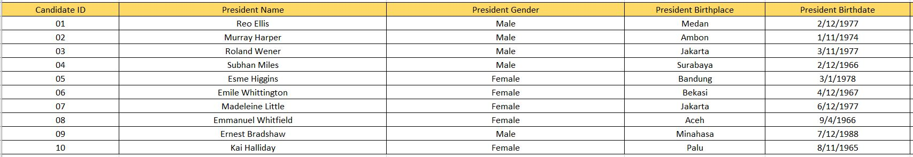
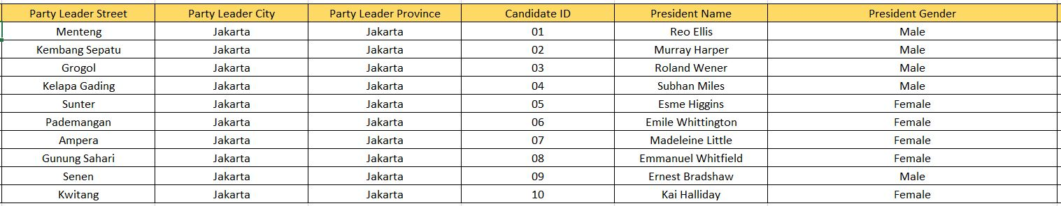
1NF
Table Name: Election

Slide 5
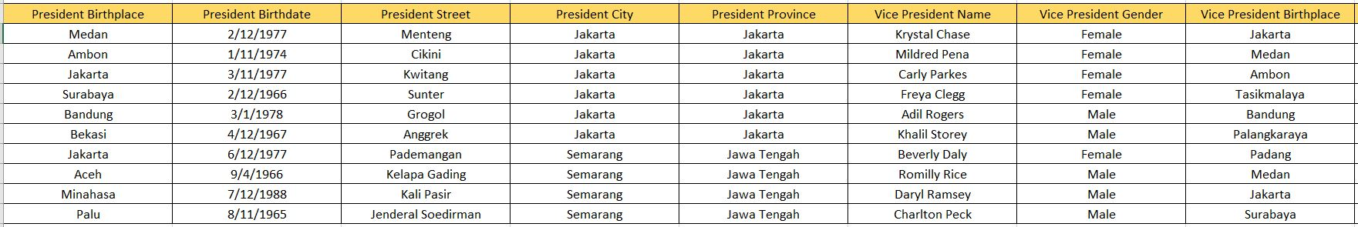
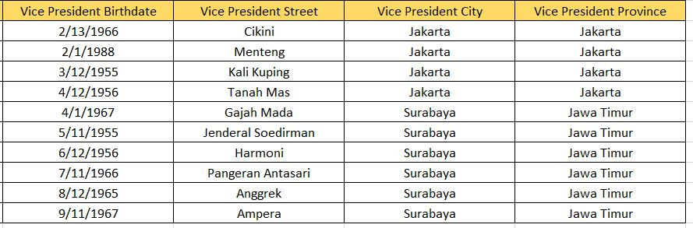
1NF

Slide 6
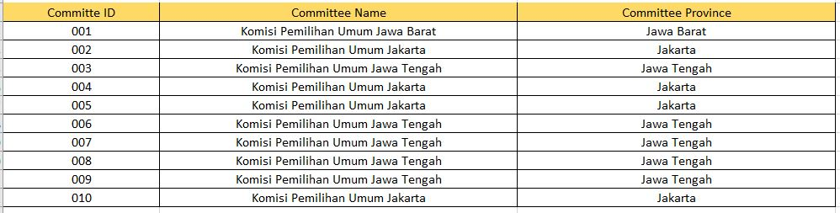
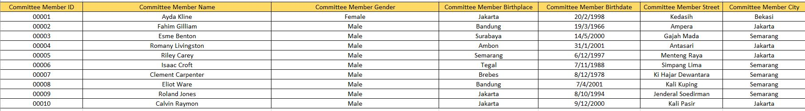
1NF

Slide 7
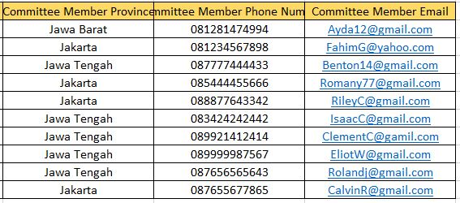
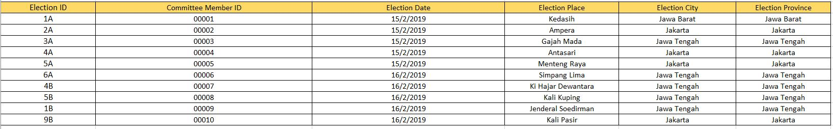
1NF

Slide 8
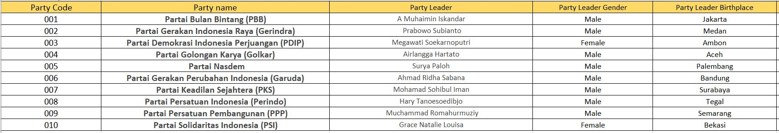
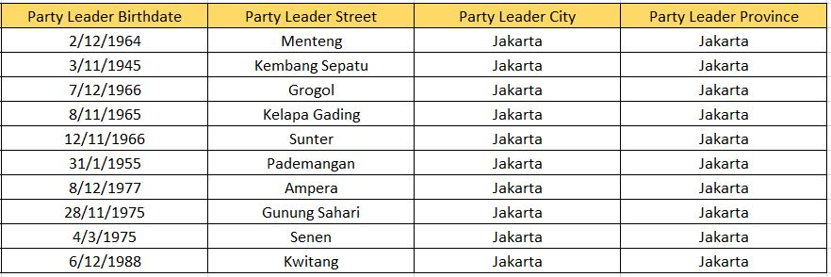
1NF

Slide 9
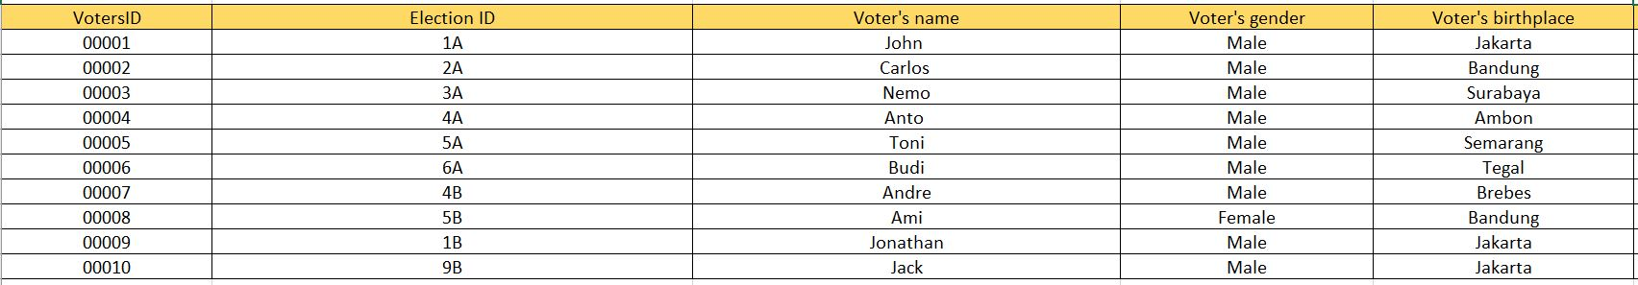
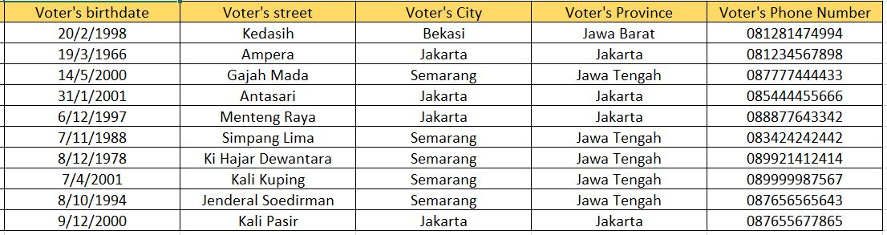
1NF

Slide 10
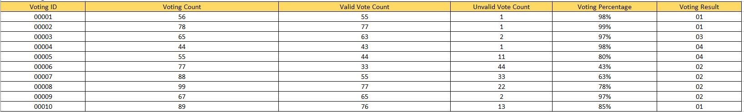
1NF

Slide 11
2NF

Slide 12
2NF
Table Name: Voters

Slide 13
2NF
Table Name: Candidate

Slide 14
2NF

Slide 15
2NF

Slide 16
2NF
Table Name: Committee

Slide 17
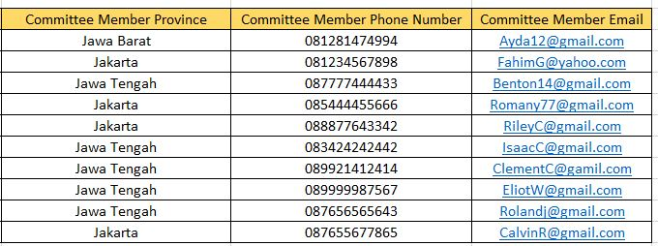
2NF

Slide 18
2NF
Table Name: Election Place

Slide 19
3NF

Slide 20
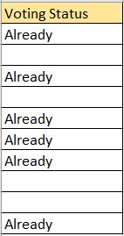
3NF
Table Name: Voters

Slide 21
3NF
Table Name: Party

Slide 22
3NF
Table Name: Candidate

Slide 23
3NF

Slide 24
3NF
Table Name: Committee Member

Slide 25
3NF
Table Name: Committee

Slide 26
3NF
Table Name: Election Place

Slide 27
SQL Server management
Studio
tables

Slide 28
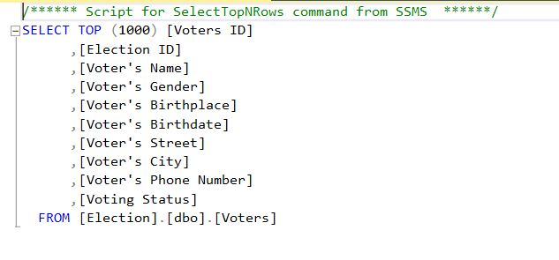
SQL Server management Studio tables
Table Name: Voters

Slide 29
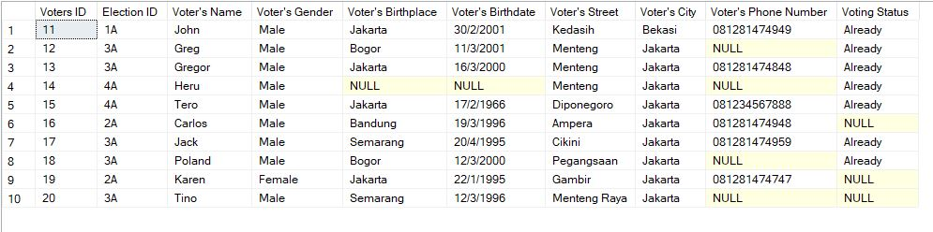
SQL Server management Studio tables
Table Name: Voters

Slide 30
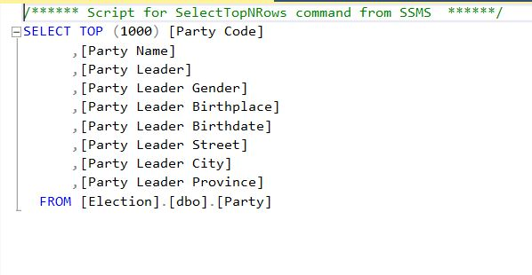
SQL Server management Studio tables
Table Name: Party

Slide 31
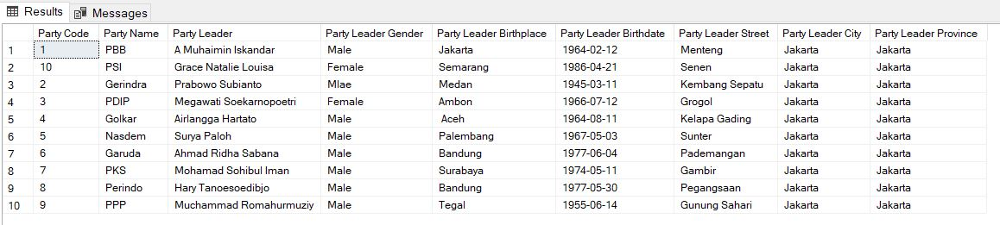
SQL Server management Studio tables
Table Name: Party

Slide 32
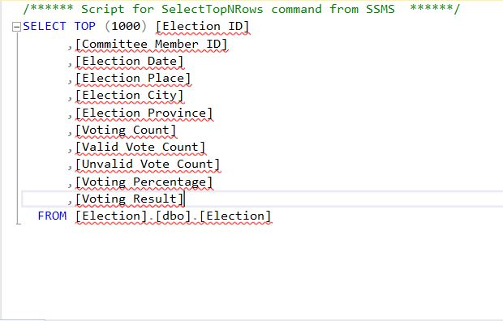
SQL Server management Studio tables
Table Name: Election

Slide 33
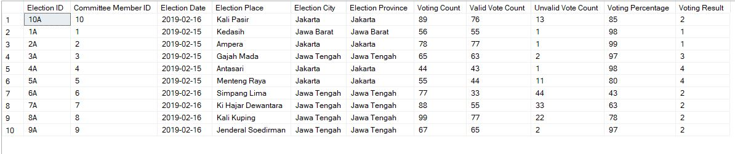
SQL Server management Studio tables
Table Name: Election

Slide 34
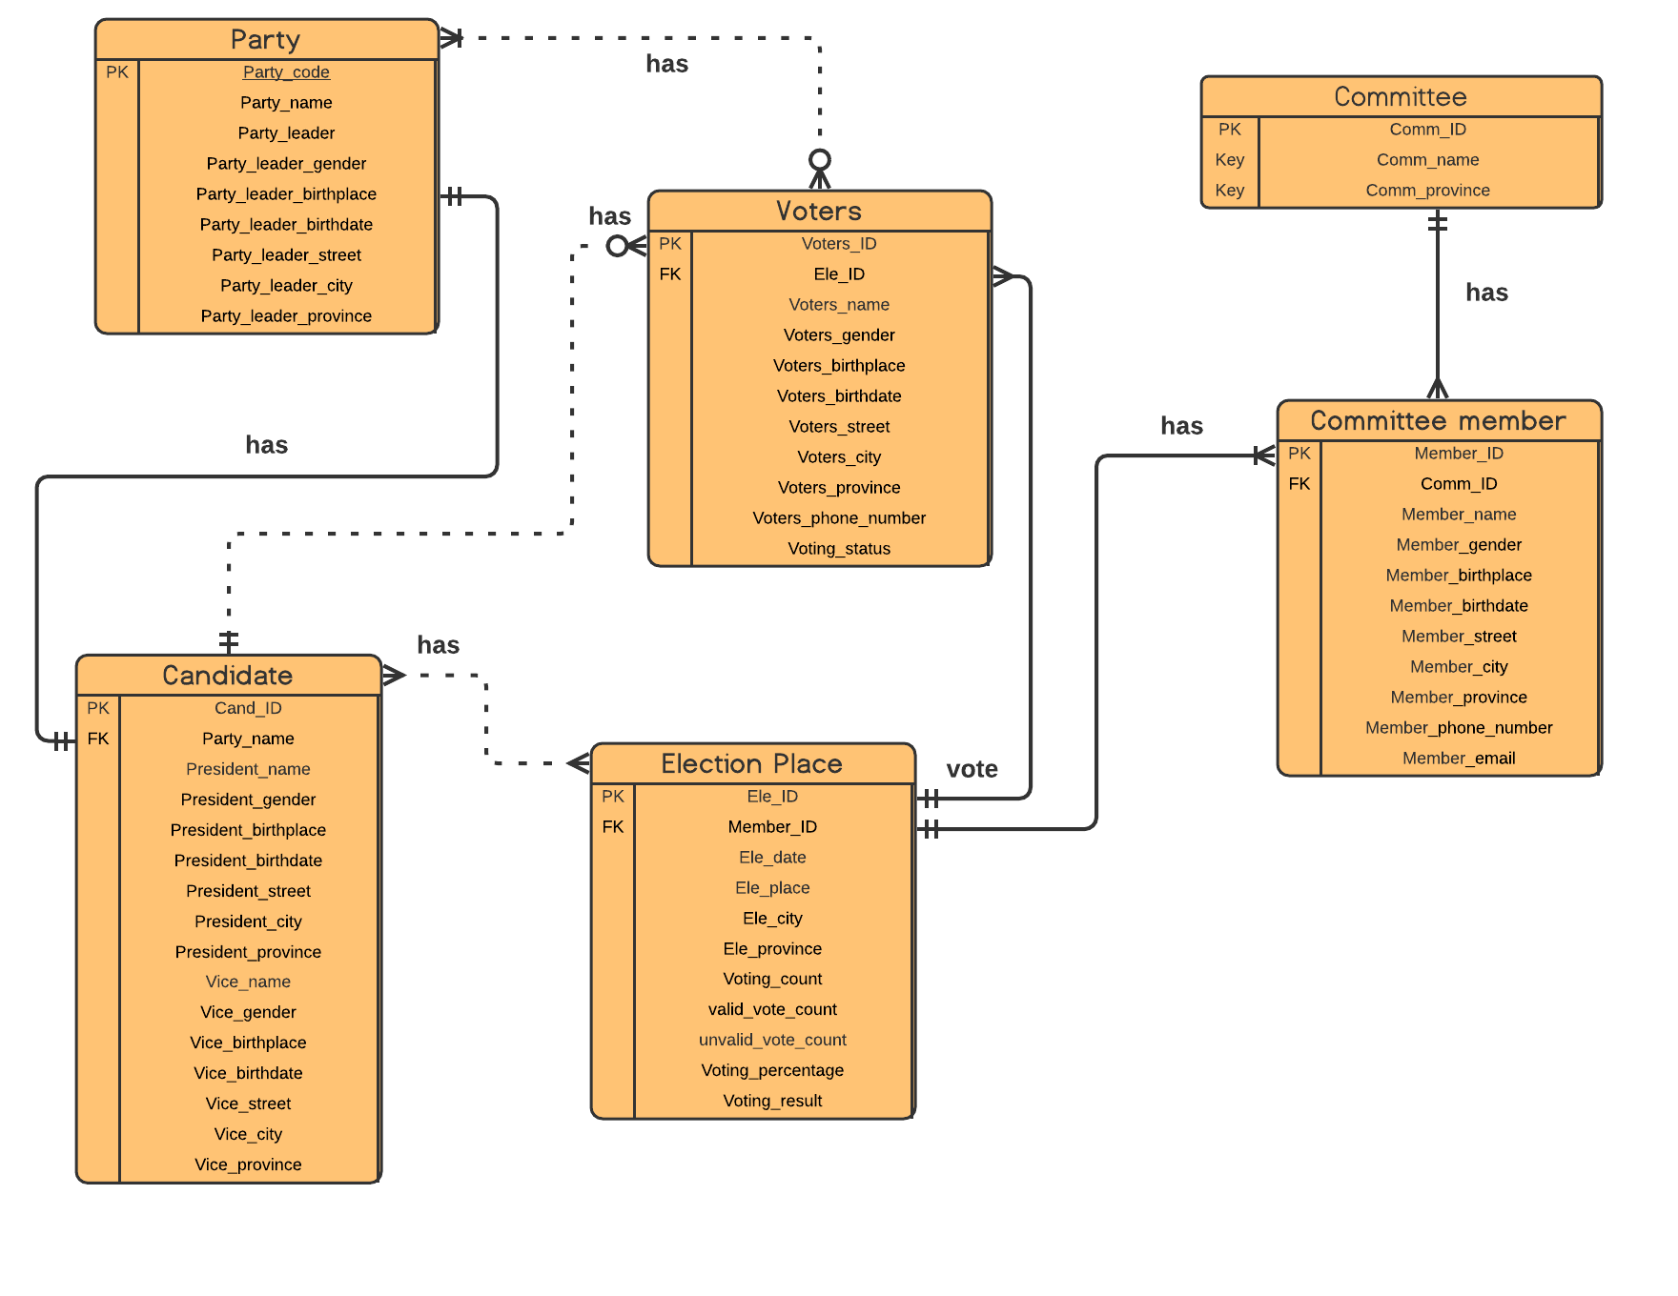
2NF

Slide 35
THANK YOU

